Slide 1
Programming Machine Learning Applications
Lecture Eight: Association Rule Mining
Dr. Aleksandar Velkoski

Slide 2
Review of Lecture Seven
Clustering
Principal Component Analysis
Code

Slide 3
Lecture Eight
Association Rule Mining
Code

Slide 4
Association Rule Mining

Slide 5
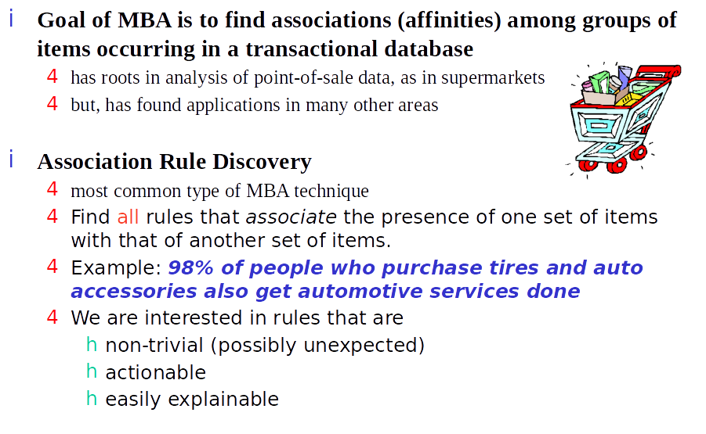
Market Basket Analysis

Slide 6
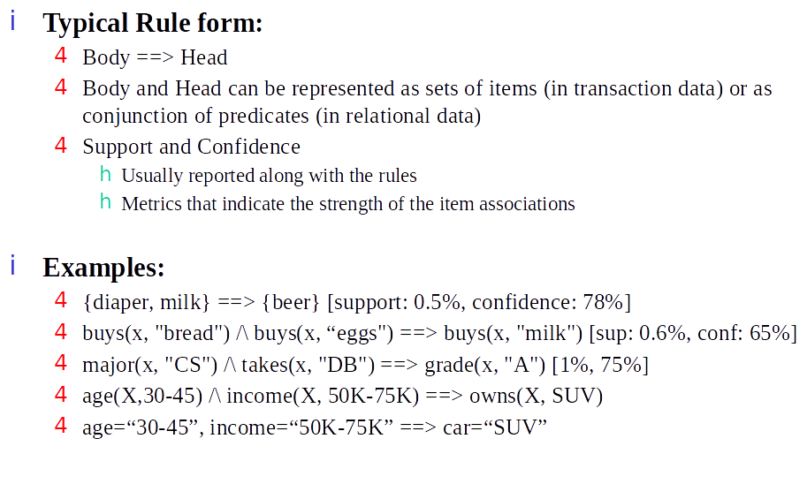
Format of Association Rules

Slide 7
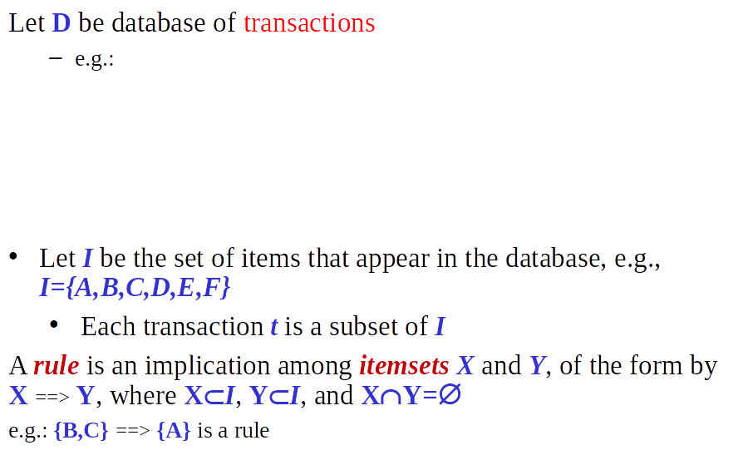
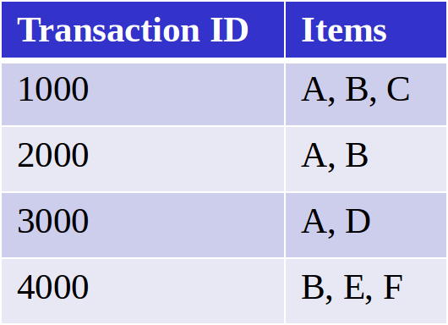
Association Rules - Basic Concepts

Slide 8
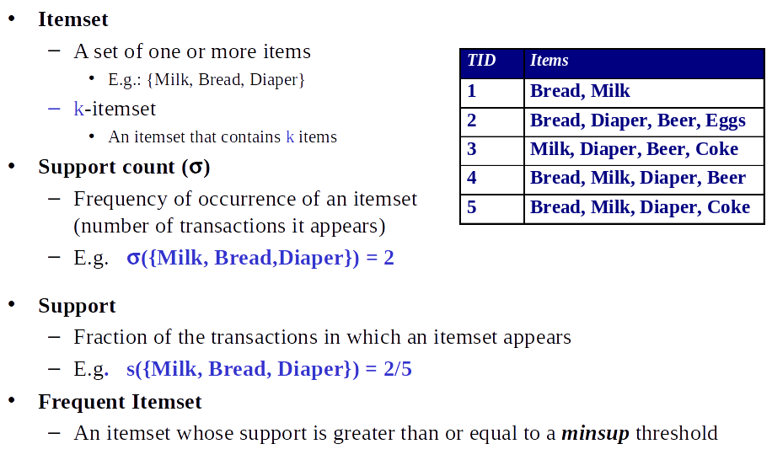
Association Rules - Basic Concepts

Slide 9
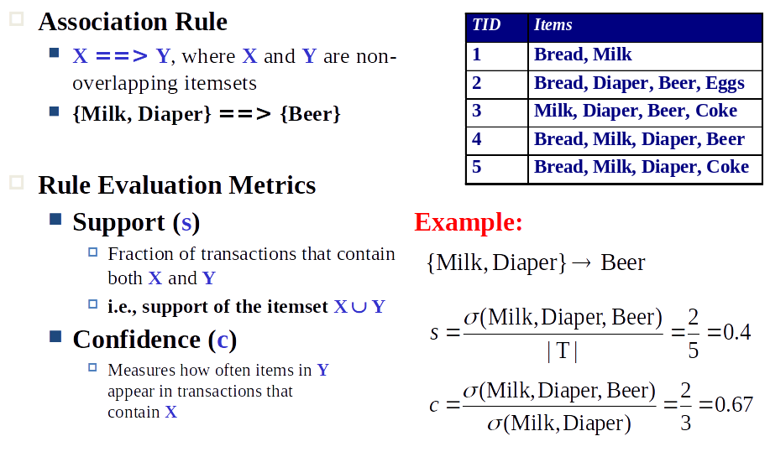
Association Rules - Basic Concepts

Slide 10
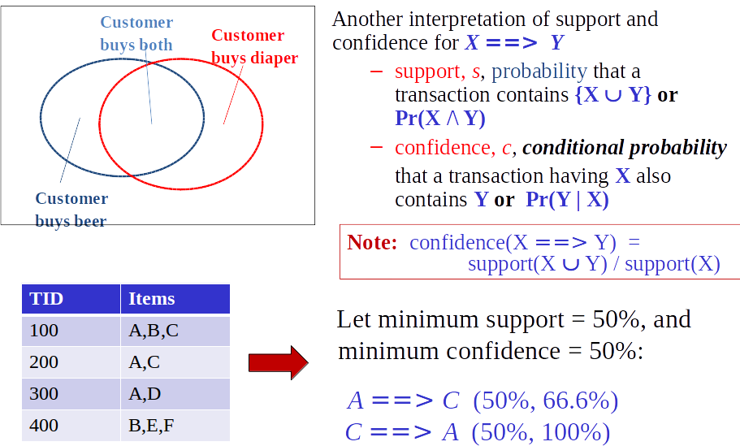
Association Rules - Basic Concepts

Slide 11
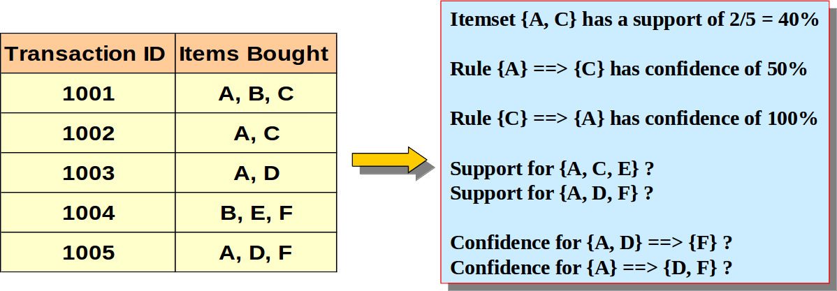
Support and Confidence - Example

Slide 12
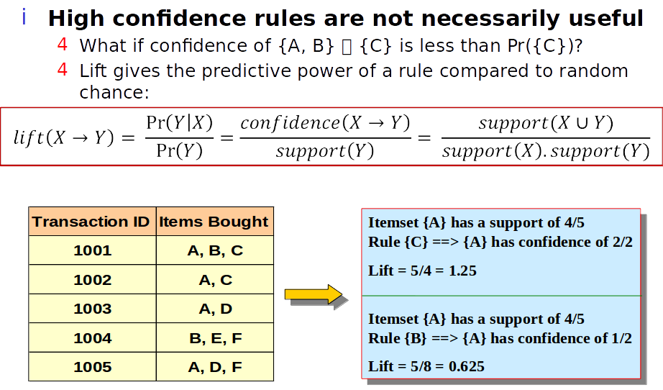
Lift (Improvement)

Slide 13
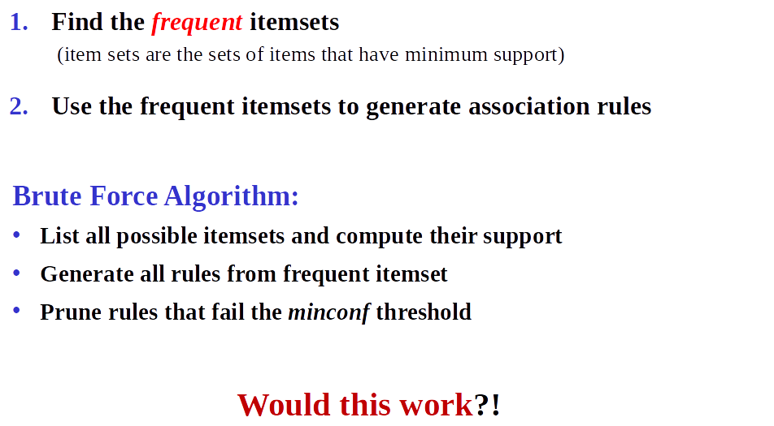
Steps in Association Rule Discovery

Slide 14
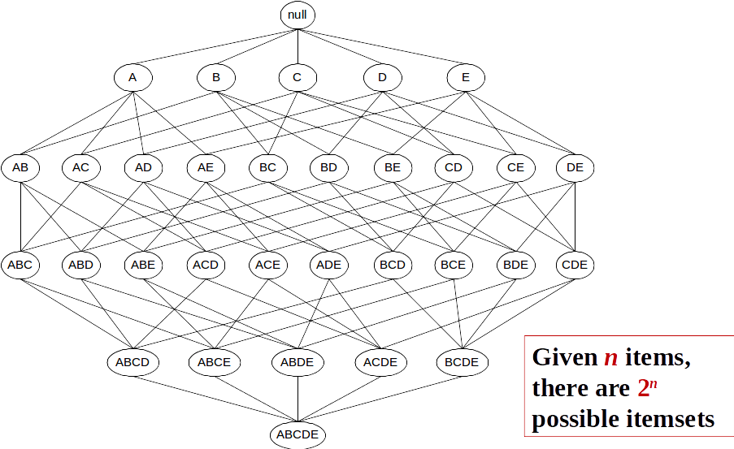
How Many Itemsets are there?

Slide 15
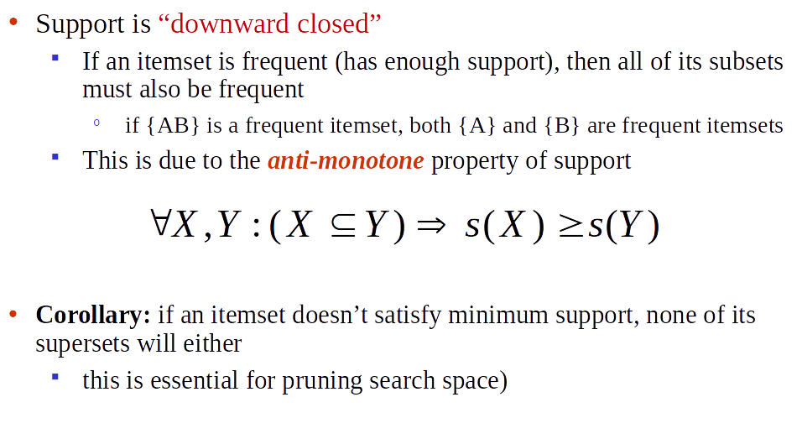
Solution: The Apriori Principle

Slide 16
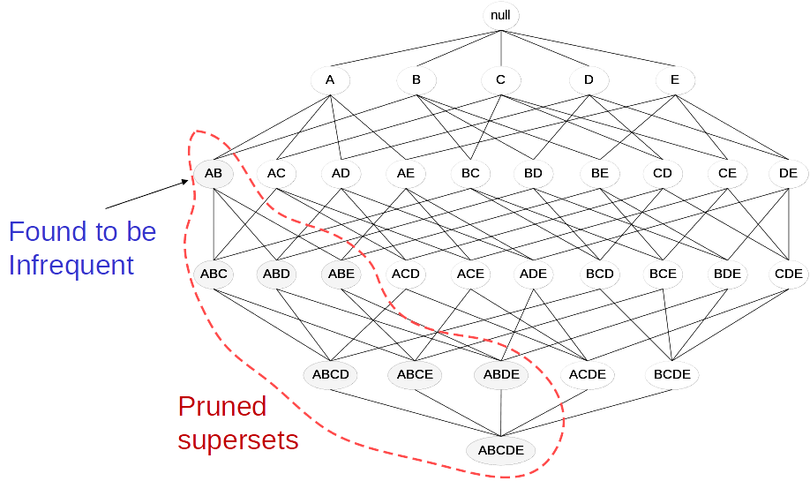
The Apriori Principle

Slide 17
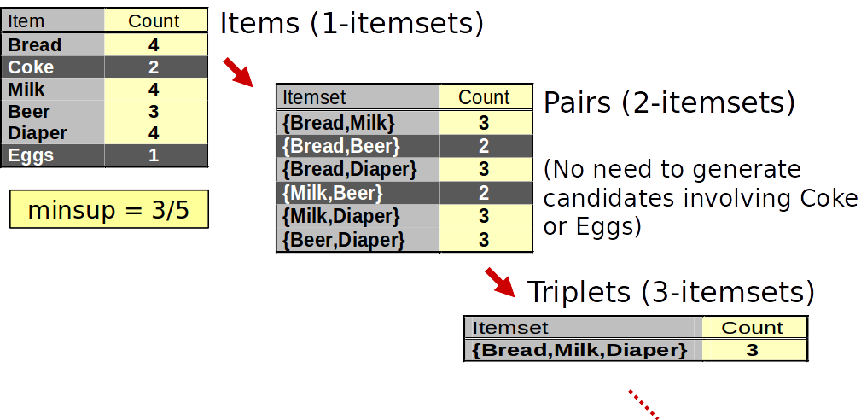
Support-Based Pruning

Slide 18
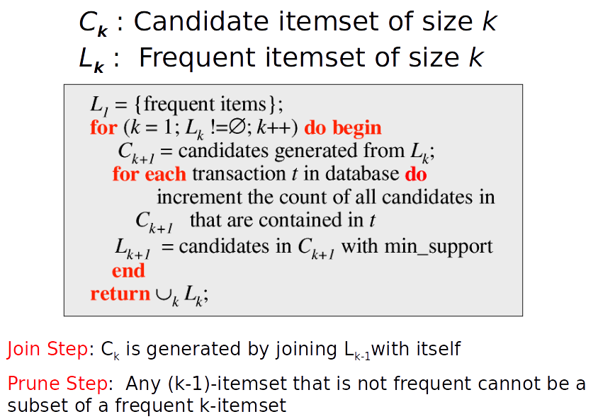
The Apriori Algorithm

Slide 19
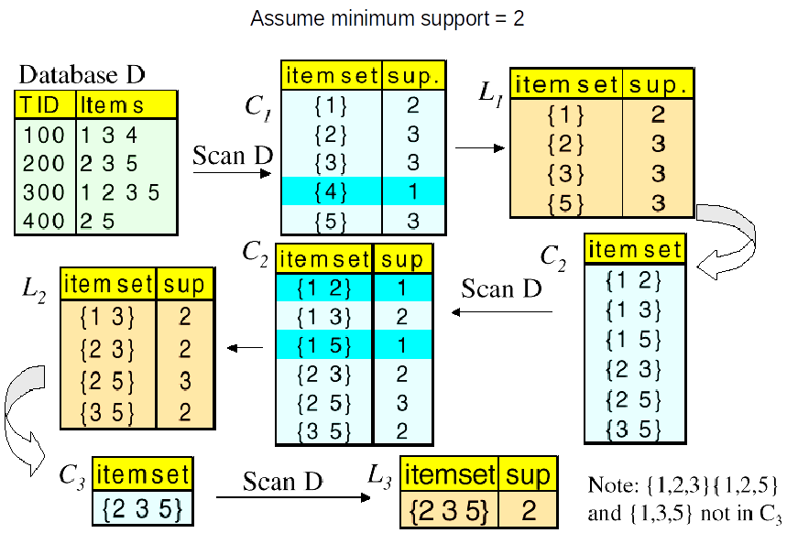
The Apriori Algorithm - An Example

Slide 20
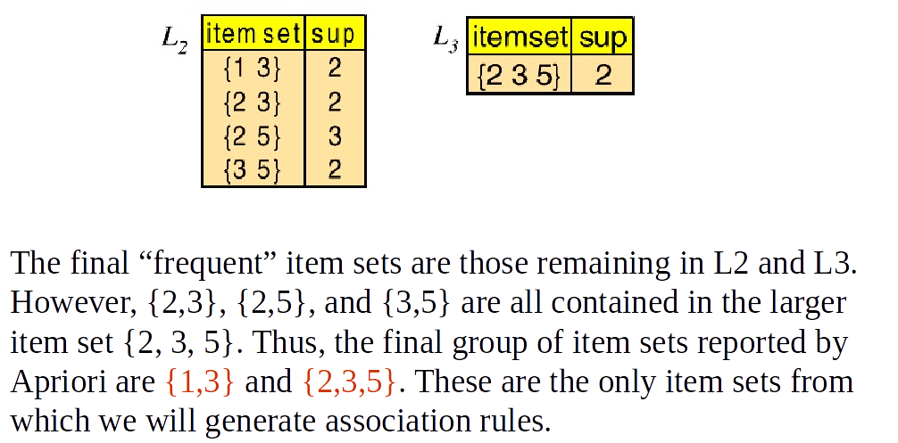
The Apriori Algorithm - An Example

Slide 21
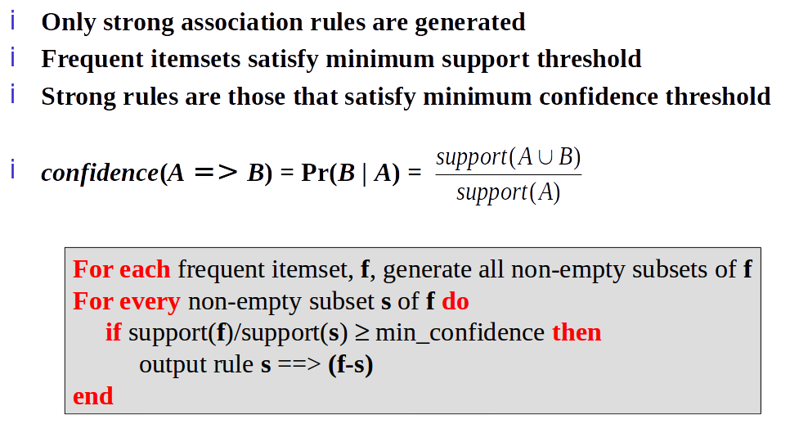
Generating Rules from Frequent Itemsets

Slide 22
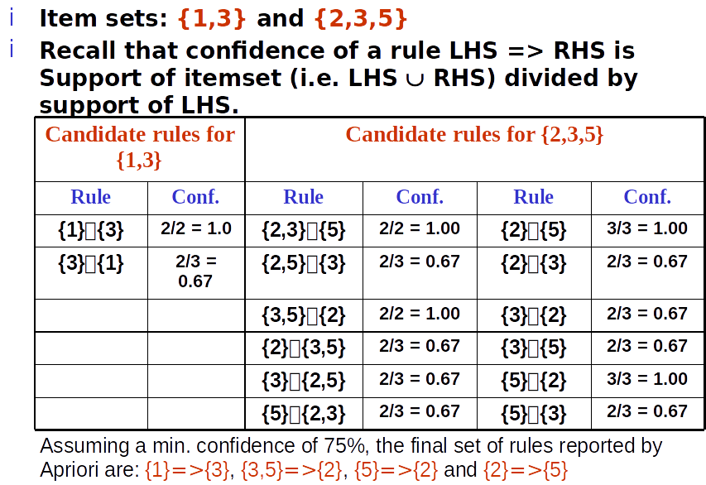
Generating Rules from Frequent Itemsets

Slide 23
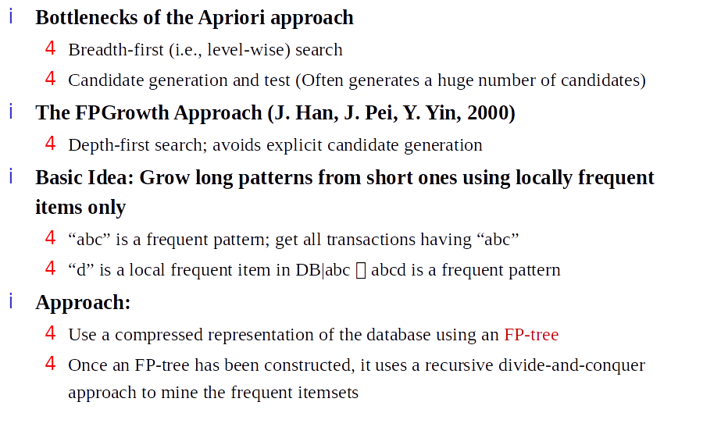
Frequent Patterns w/o Candidate Generation

Slide 24
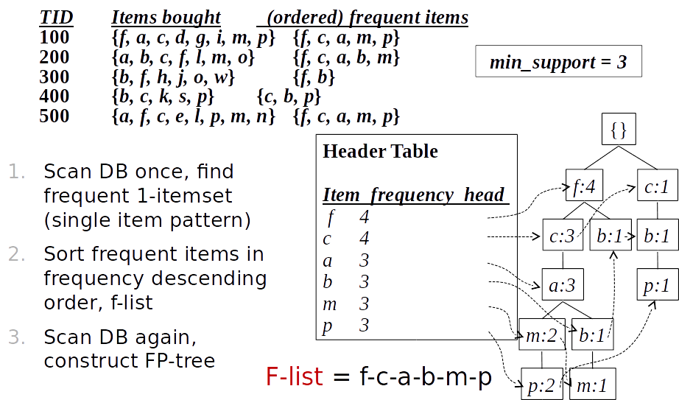
FP-Growth: FP-Tree from Database

Slide 25
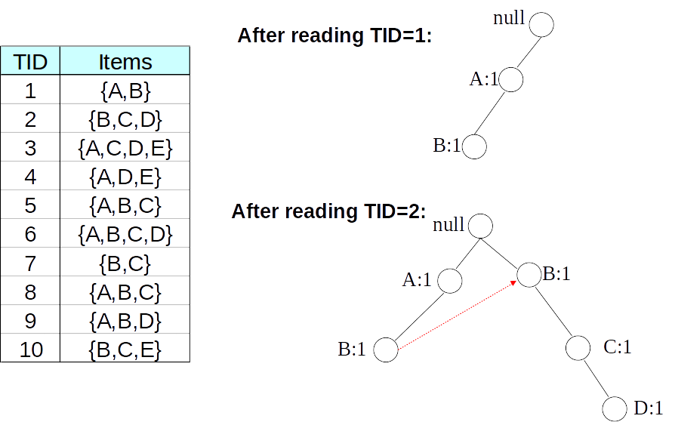
FP-Tree Construction - Example

Slide 26
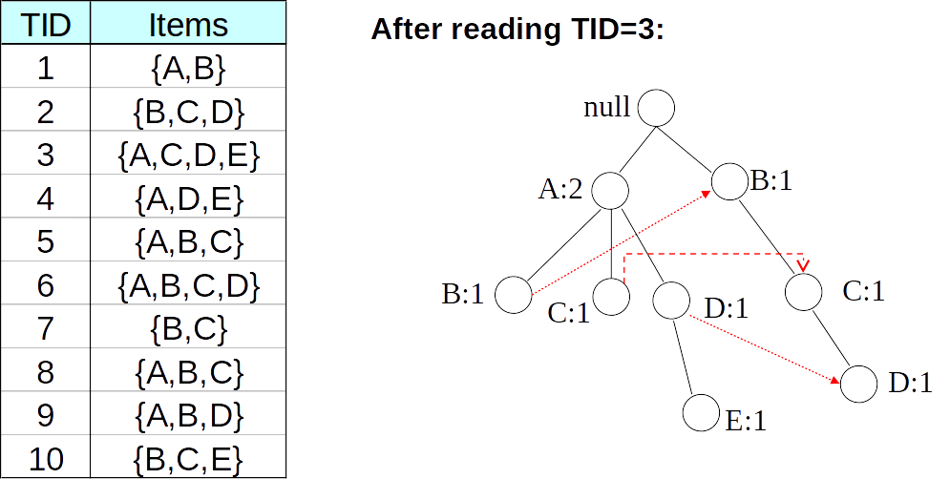
FP-Tree Construction - Example

Slide 27
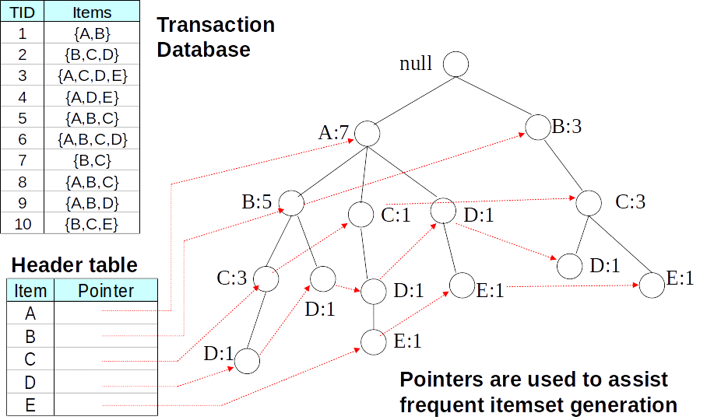
FP-Tree Construction - Example

Slide 28
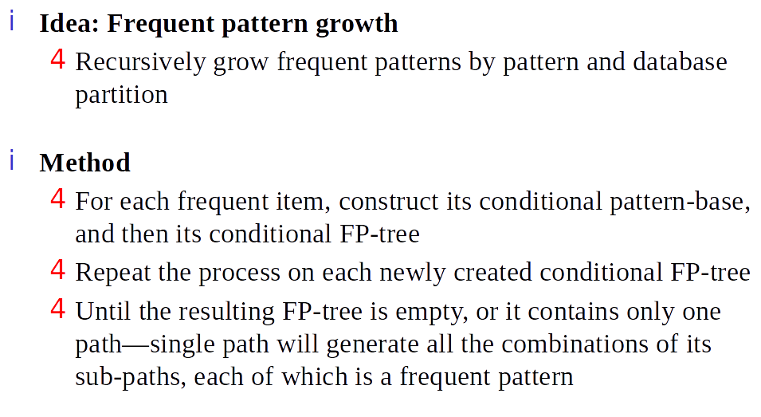
FP-Growth Summary

Slide 29
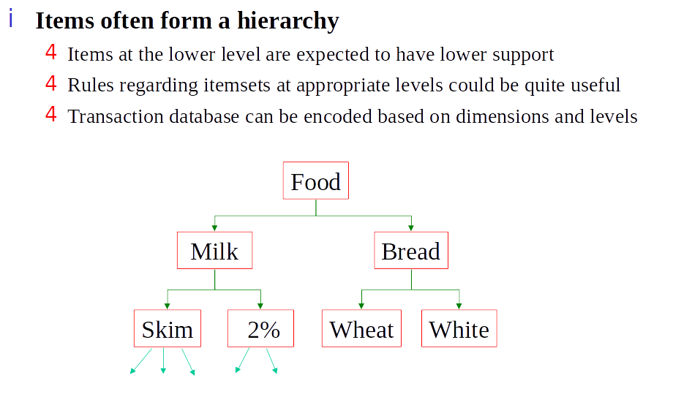
Extensions: Multi-Level Rules

Slide 30
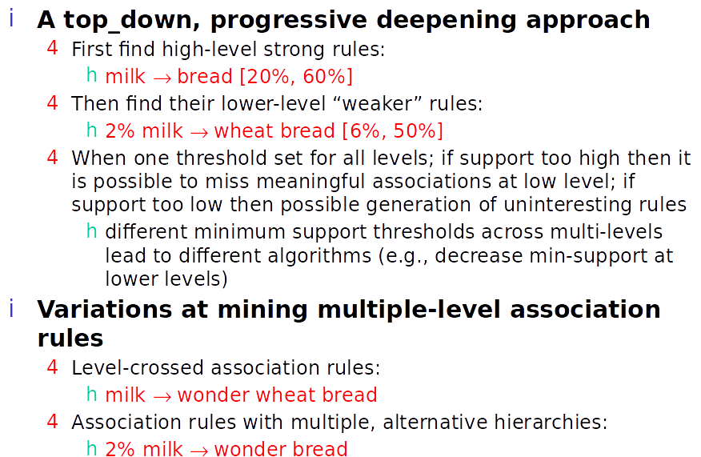
Extensions: Multi-Level Rules

Slide 31
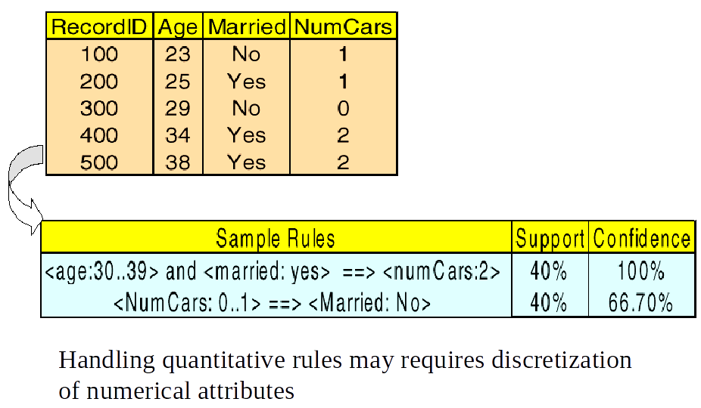
Extensions: Quantitative Rules

Slide 32
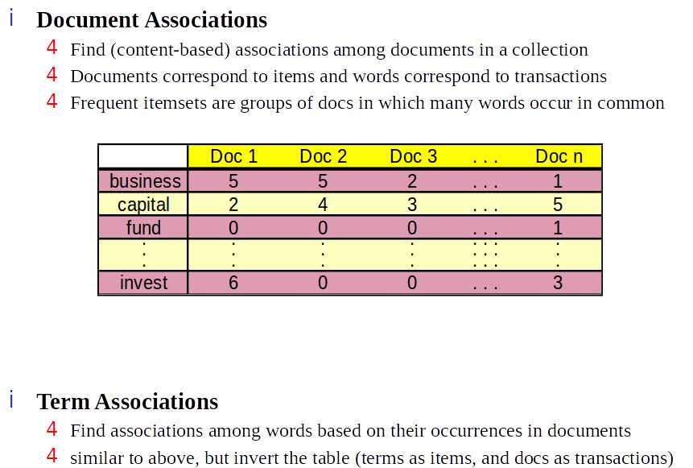
Associations in Text Mining

Slide 33
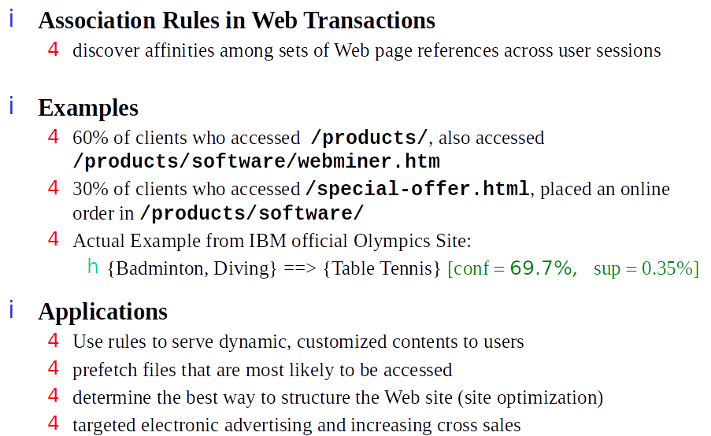
Associations in Web Mining

Slide 34
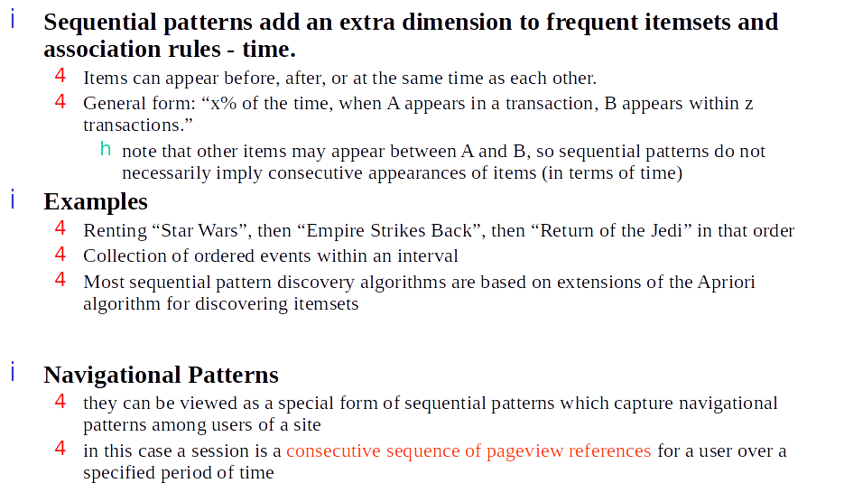
Sequential Patterns

Slide 35
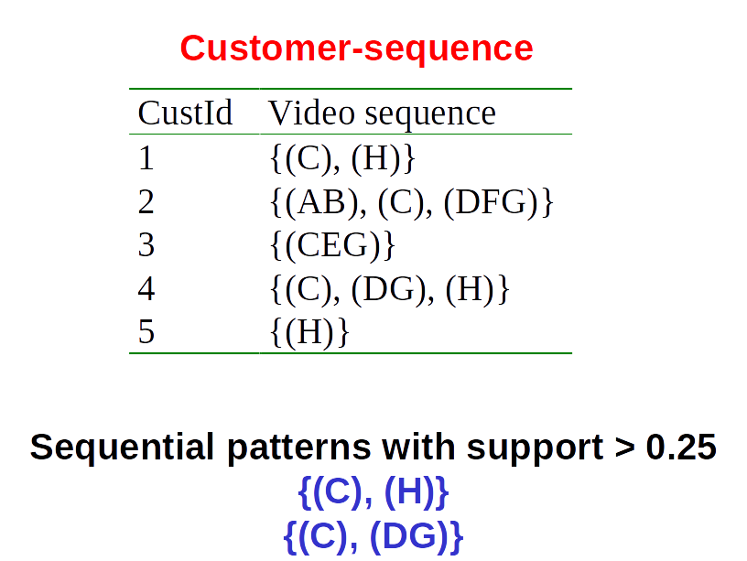
Sequential Patterns - Example

Slide 36
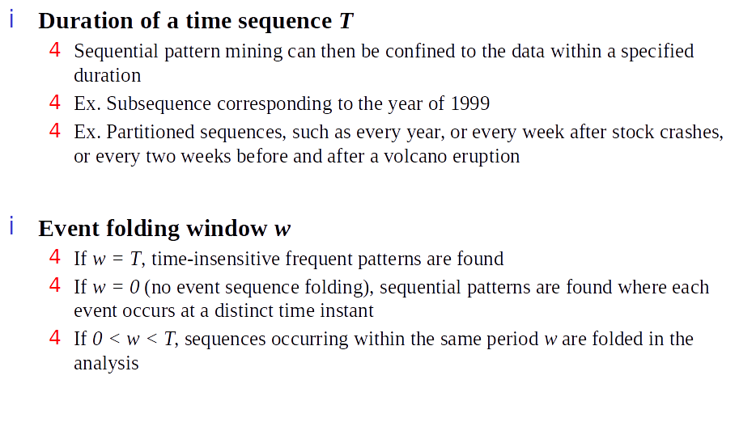
Sequential Patterns - Cases and Parameters

Slide 37
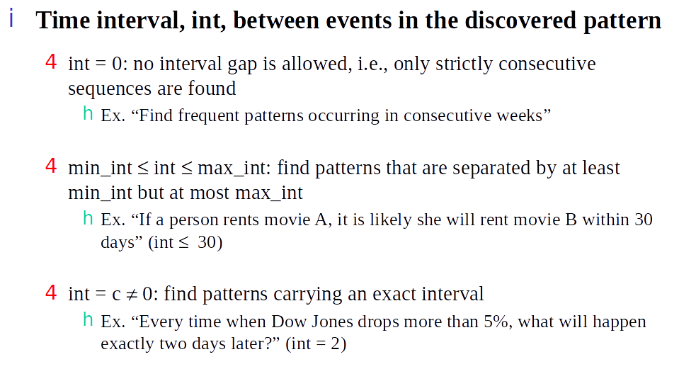
Sequential Patterns - Cases and Parameters

Slide 38
Code

Slide 39
Questions
Wrapping-up the Lecture

